Slide 1








TITLE: Digital Platform for Formal E-Waste Collection and Recycling
TEAM NAME: VITAL EDGERS
TEAM ID: YS528
PS ID: 19
DOMAIN: SOFTWARE
TEAM LEADER NAME: MALACK MOHAMMED HASSAN
MEMBER-1 NAME: MOHAMMED FARAAZ ISHAQUE M
MEMBER-2 NAME: MOHAMMED SAAD R K
MEMBER-3 NAME: MOHAMMED IRFAN S
MEMBER-4 NAME: MOHAMMED ASRAR U

Slide 2

PROBLEM STATEMENT
A large amount of e-waste is collected through informal channels. Informal collectors are important to the recycling ecosystem, but they often lack transparent prices, direct access to authorized recyclers, safe-handling guidance and reliable transaction records.
Key difficulties:
• Collectors may receive unclear or unfair prices.
• Authorized recyclers have difficulty discovering and verifying collected material.
• Collection and handover records are often fragmented or paper-based.
• The journey of e-waste from collection to recycling is difficult to track.
• Unsafe handling of batteries, circuit boards and electronic components can create health and environmental risks.
• Poor connectivity and limited digital literacy reduce access to existing digital services.
Core problem: There is no simple, accessible and traceable digital bridge between informal collectors and the formal recycling ecosystem.

Slide 3
PROPOSED SOLUTION
We propose a low-connectivity digital platform that connects e-waste collectors with authorized recyclers and manages the complete collection-to-recycling journey.
The platform will:
• Allow collectors to register and create e-waste lots.
• Record category, weight, condition and location.
• Estimate a fair value for collected materials.
• Warn collectors about unusually low or suspicious offers.
• Help recyclers discover and accept available lots.
• Maintain digital handover and transaction records.
• Track status from collection to recycling.
• Provide collector earnings and transaction history.
• Offer pictorial and multilingual safety guidance.
• Provide an administrator dashboard for monitoring.
Core idea: Collector → E-waste lot → Fair value → Recycler matching → Handover → Recycling record

Slide 4
OBJECTIVE
Connect informal collectors with authorized recyclers.
2. Create digital records for collected e-waste lots.
3. Provide transparent price estimates for common e-waste categories.
4. Identify potentially unfair or abnormal price offers.
5. Match e-waste lots with suitable recyclers.
6. Track each lot from creation to recycling.
7. Maintain collector earnings and transaction history.
8. Provide simple safety instructions for handling e-waste.
9. Support low-end devices and unreliable internet connections.
10. Provide dashboards for collectors, recyclers and administrators.

Slide 5
METHODOLOGY
User and requirement analysis: Identify the needs of collectors, recyclers and administrators and design simple forms and instructions.
E-waste catalogue creation: Create a catalogue for mobile phones, laptops, batteries, cables, chargers, circuit boards, printers and televisions.
Fair-value estimation: Estimate a price using category, weight, condition, age and a reference price table.
Estimated value = Base price per kg × Weight × Condition factor
Price fairness analysis: Compare an offered price with the estimated range and flag significantly low or high offers.
Lot management and matching: Create a unique lot ID, display lots to recyclers and match by category, location and capability.
Traceability: Record every status change from creation to recycling.
Dashboard and reporting: Display collection volume, transactions, earnings, pending handovers, price warnings and analytics.

Slide 6
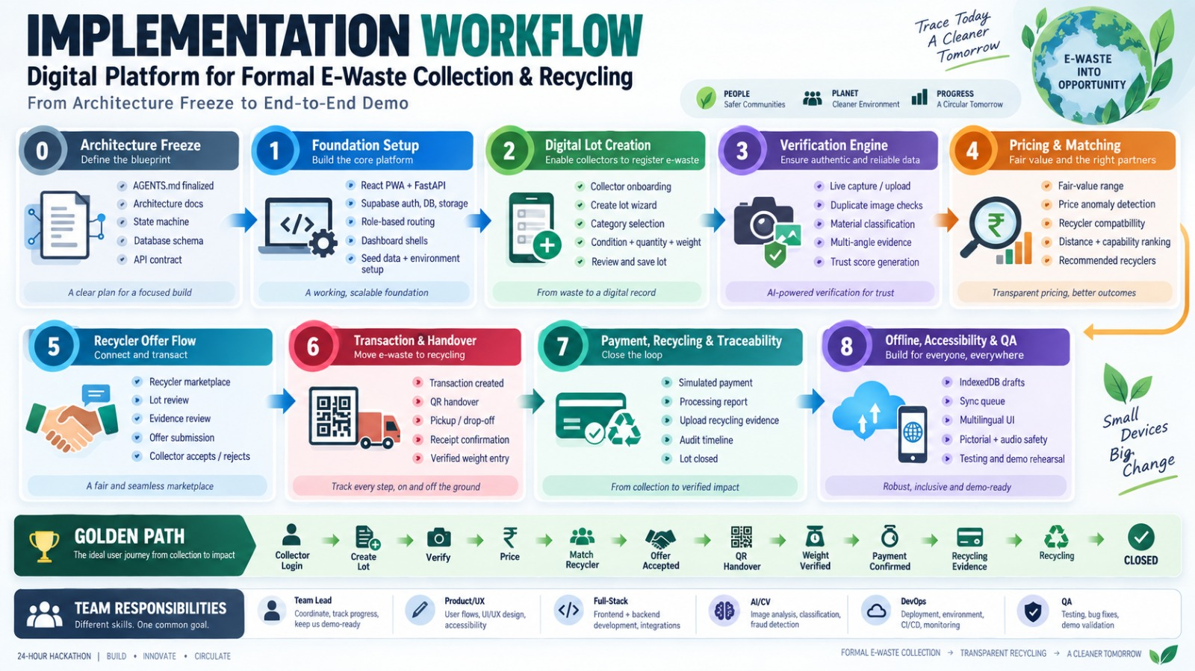
WORKFLOW

Slide 7
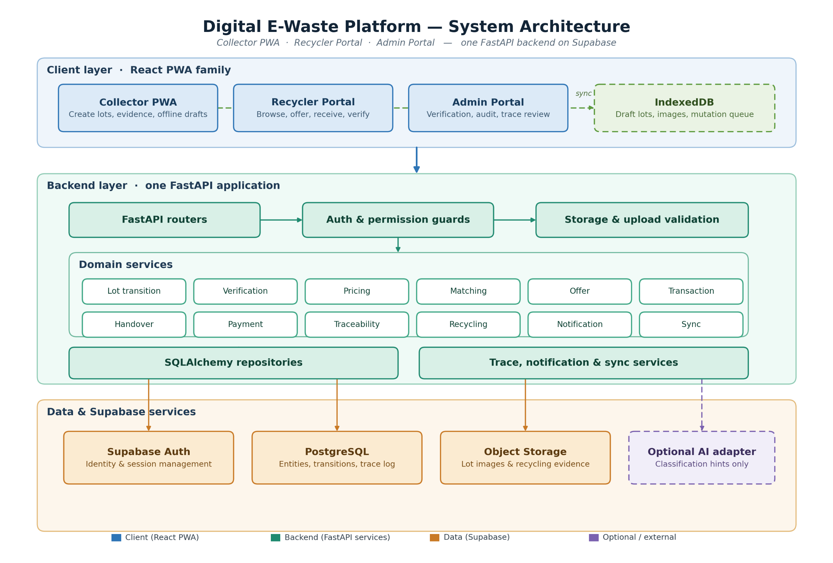
SYSTEM ARCHITECTURE

Slide 8
IMPLEMENTATION

Slide 9
IMPLEMENTATION

Slide 10



